Slide 1
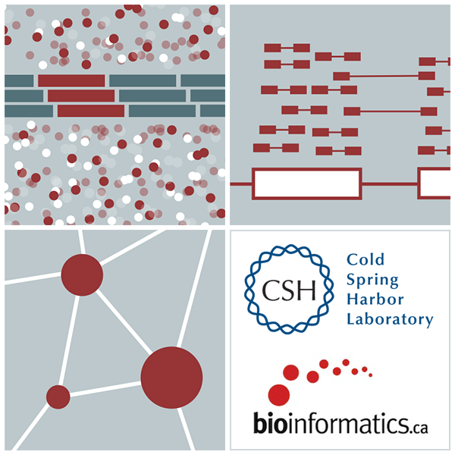
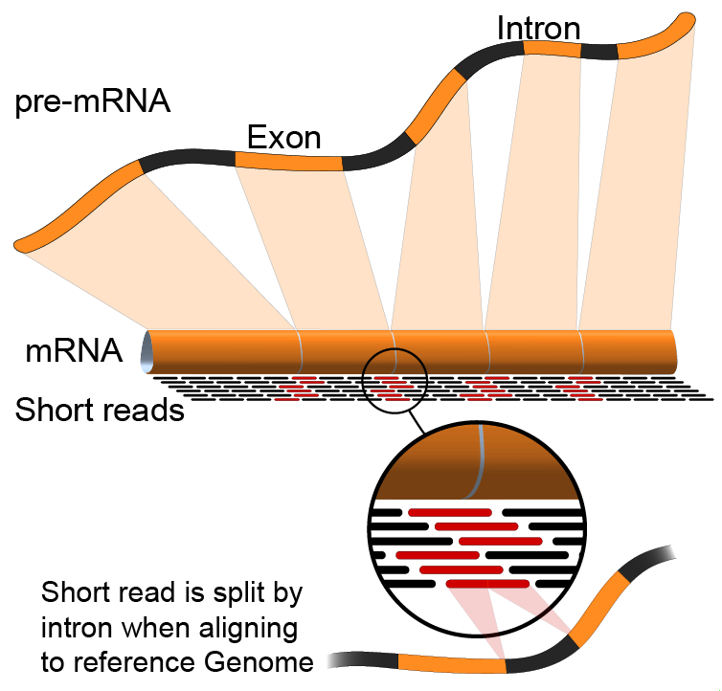

Introduction to RNA sequencing (lecture)
Felicia Gomez, Charlz Jerold, Obi Griffith, Malachi Griffith,
My Hoang, Mariam Khanfar, Chris Miller, Kartik Singhal, Jennie Yao
Advanced Sequencing Technologies & Bioinformatics Analysis November 10-21, 2025
Notes:
My name is …

Slide 2
Introduction to course – philosophy and goals
Do “the bioinformatics” for someone, and you help them for a day. Teach someone to do bioinformatics, and you help them for a lifetime.
- Ancient Chinese proverb
Course goals
Learn concepts and develop skills for sequence analysis
Build the foundation for tackling your own analysis challenges
Learn to think like a bioinformatician
Have fun

Slide 3
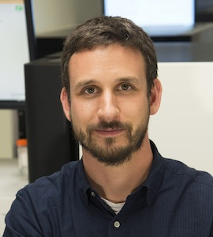
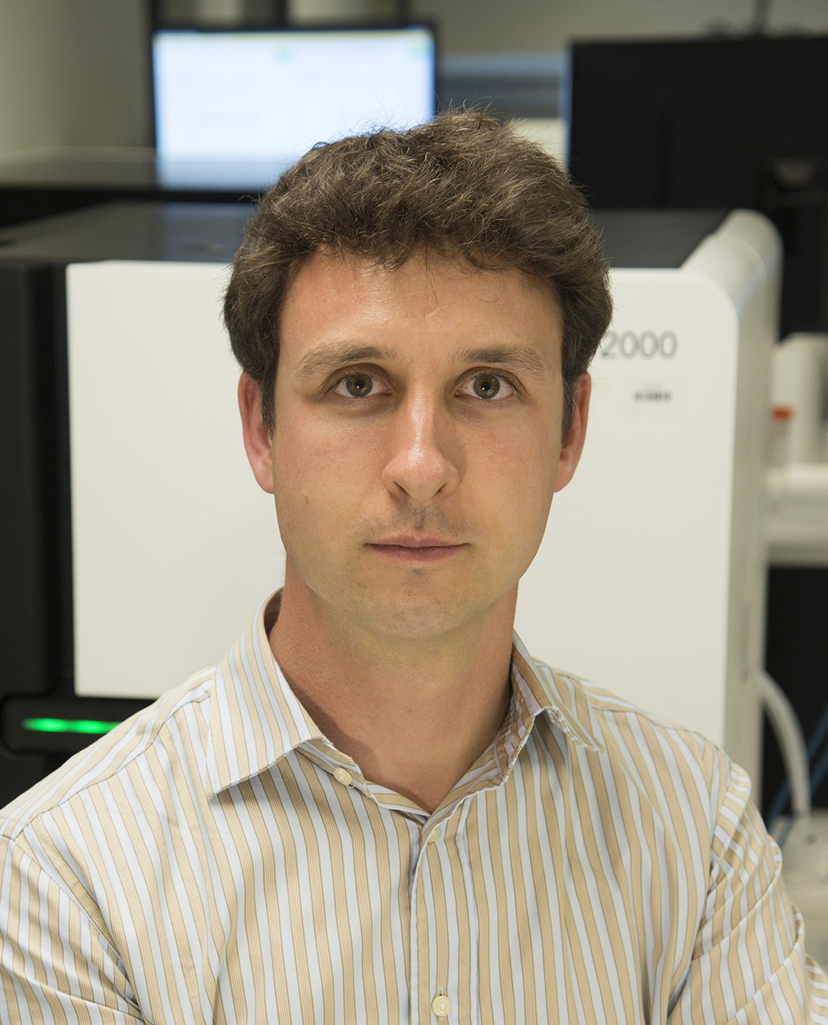
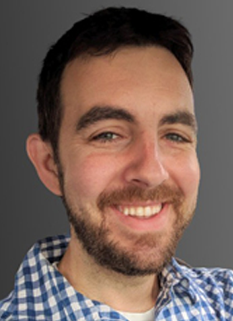
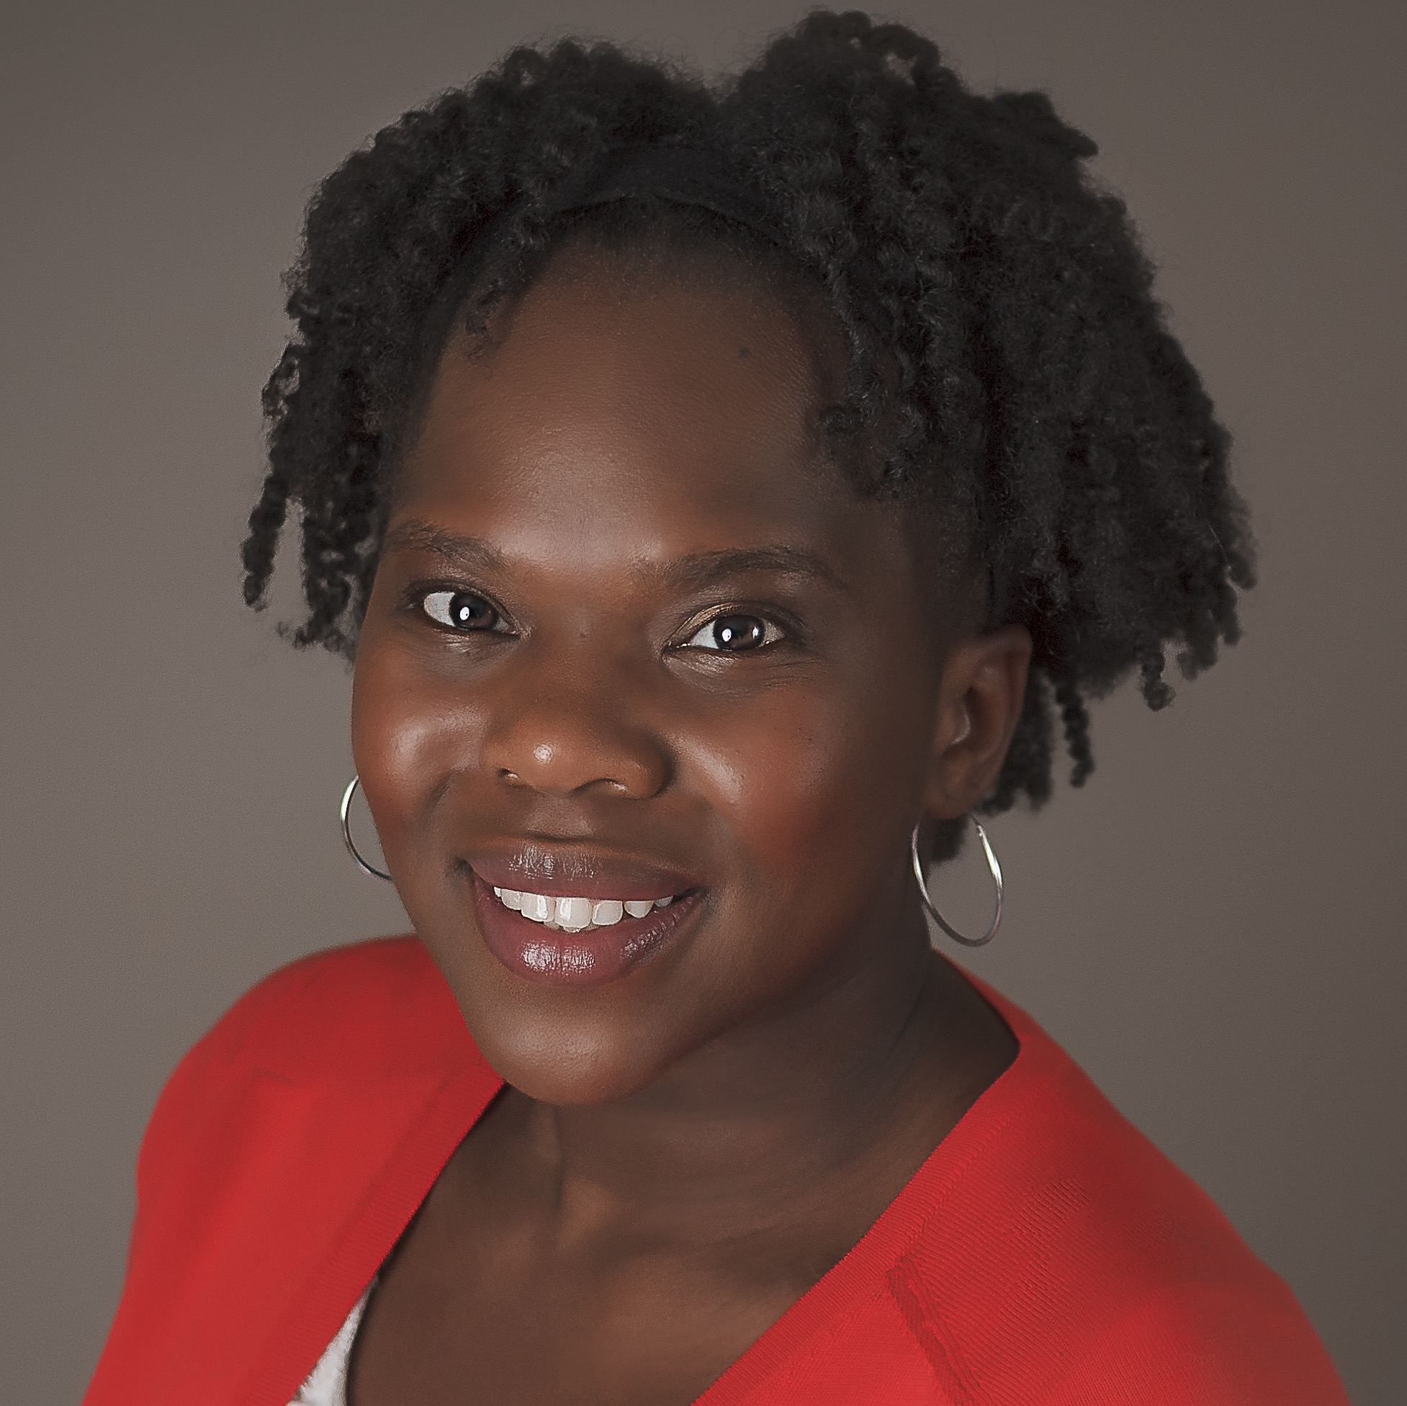

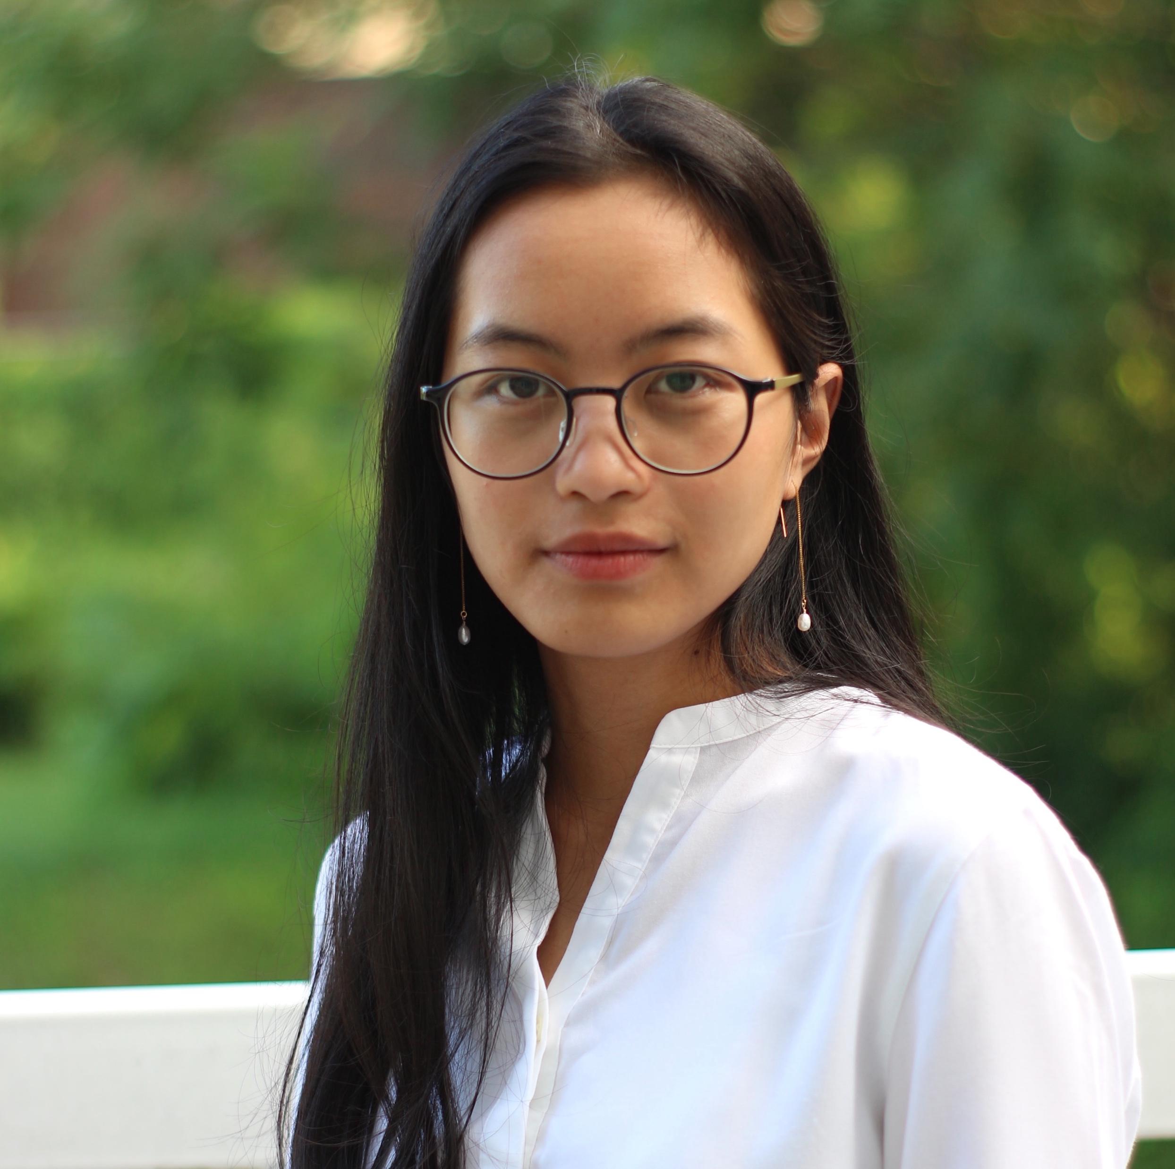
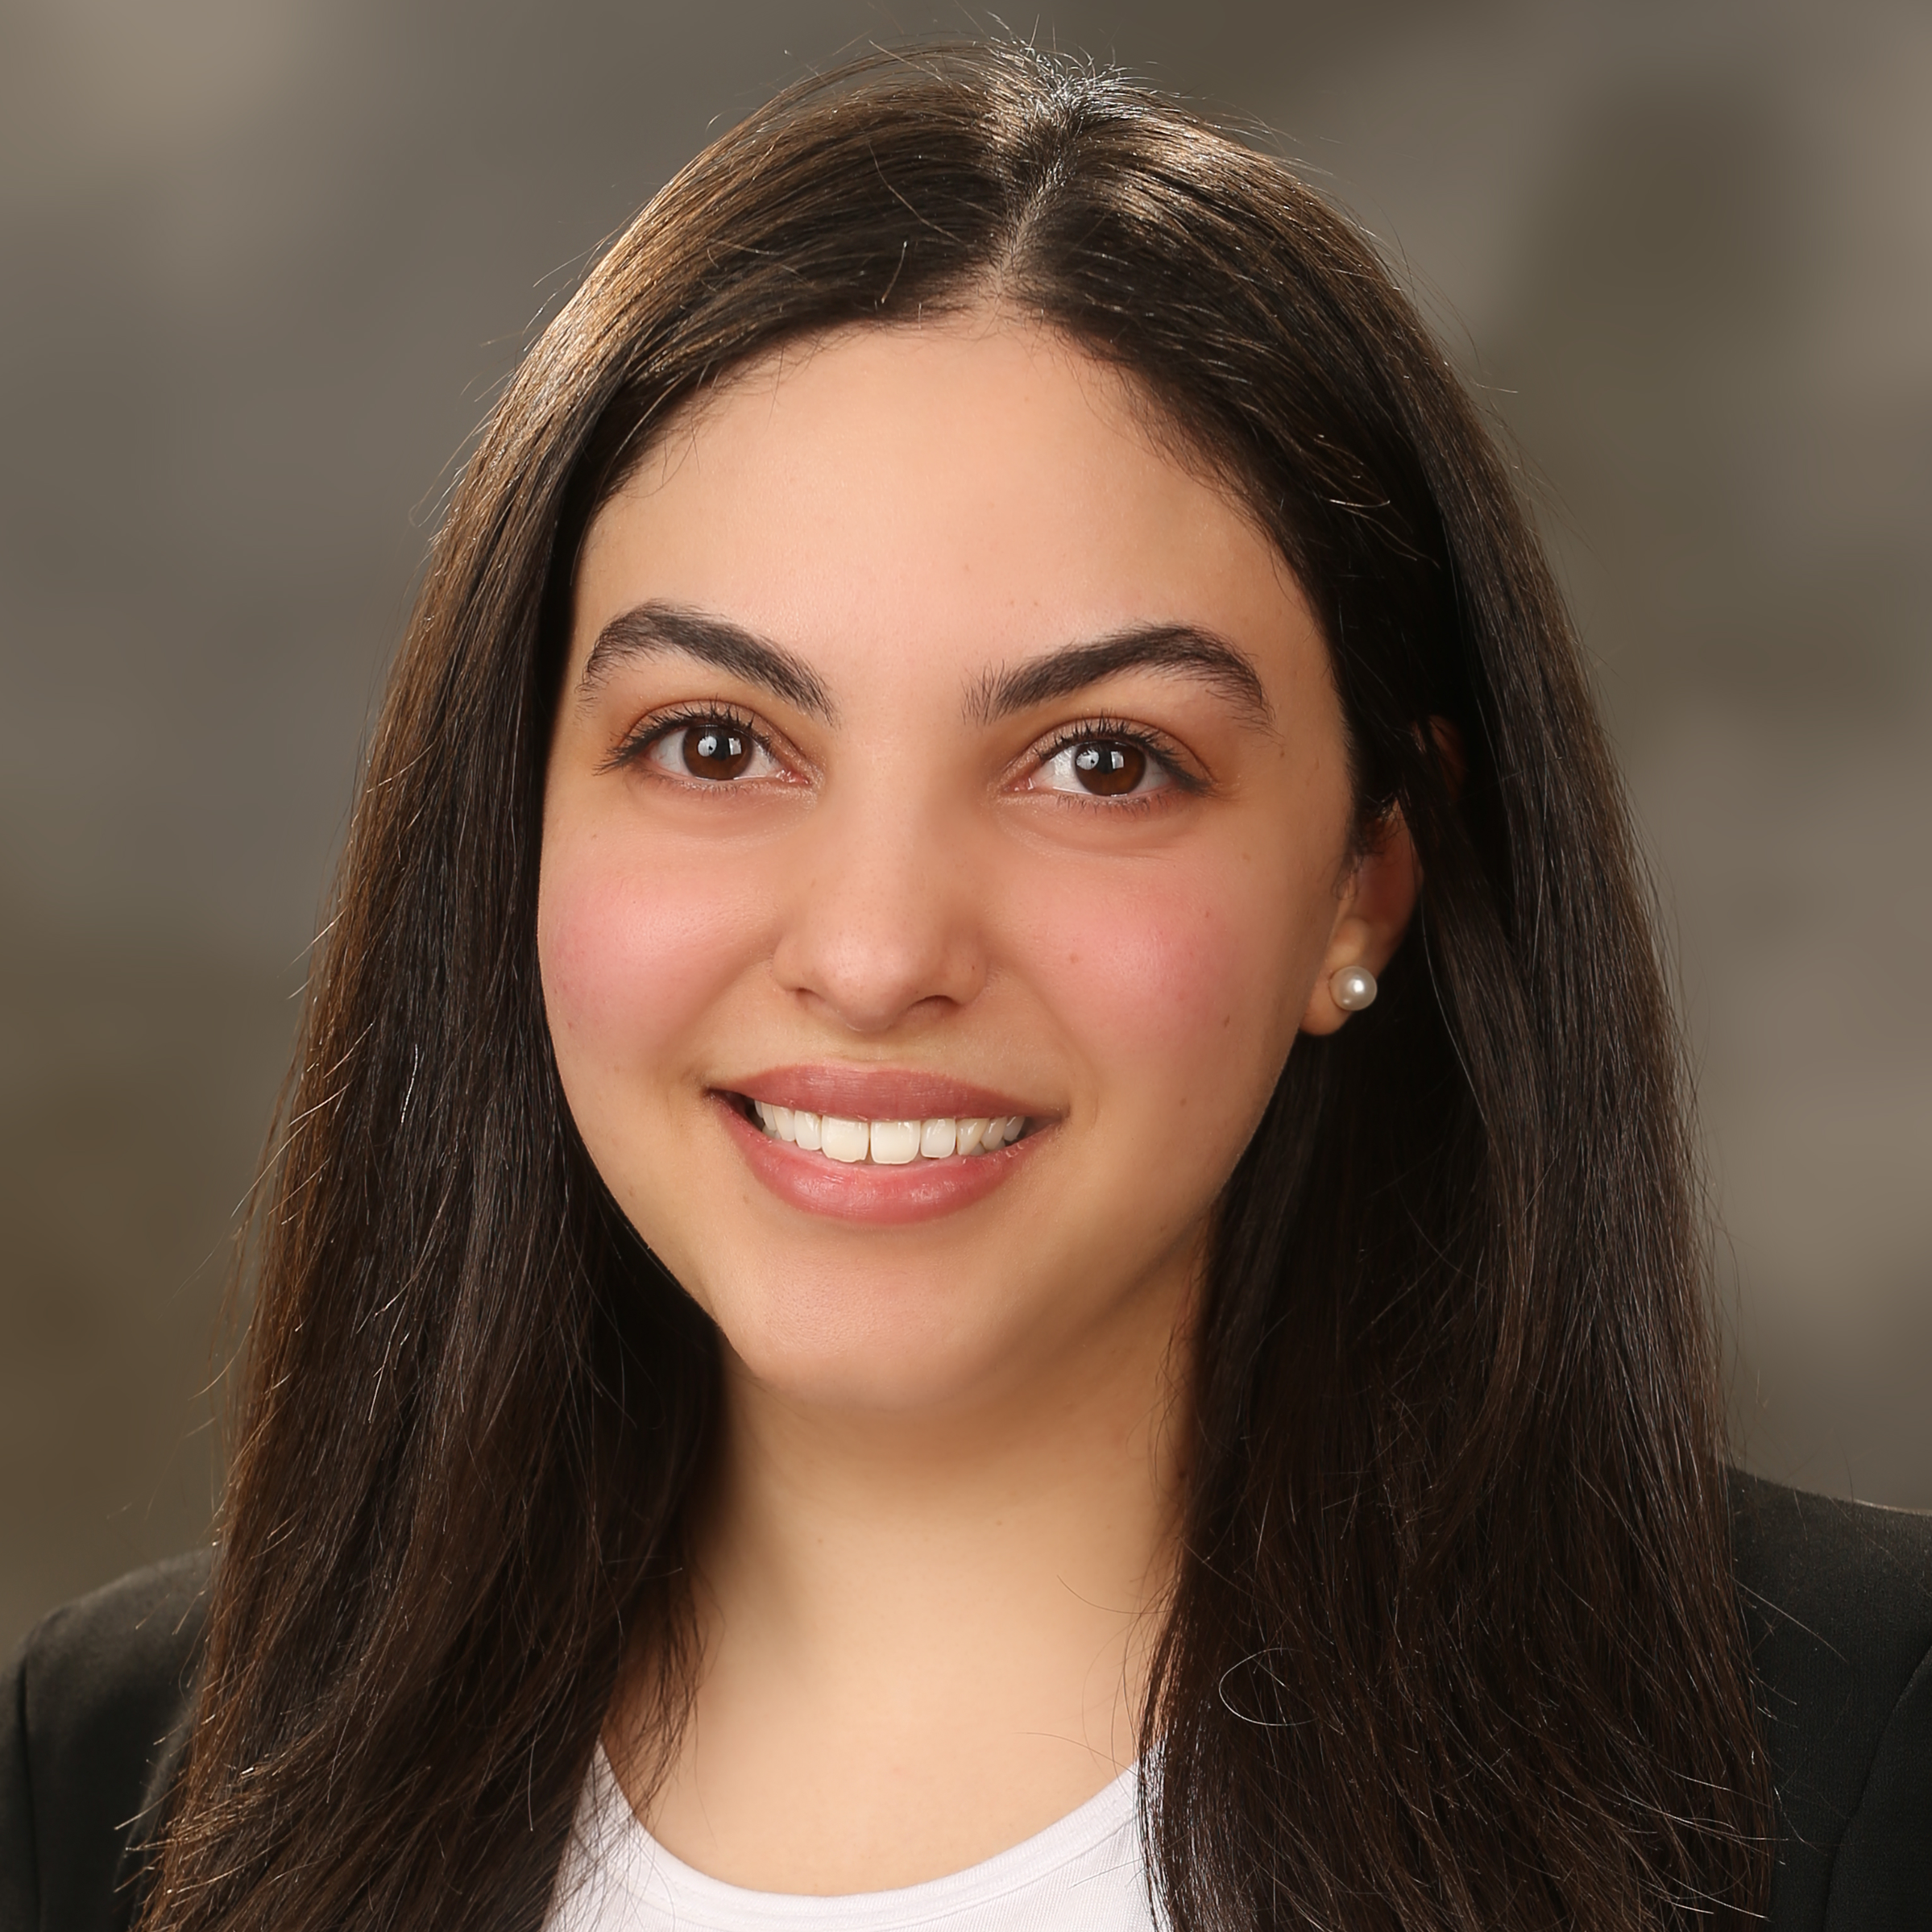
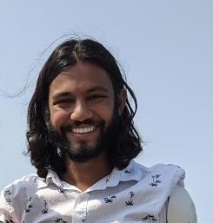
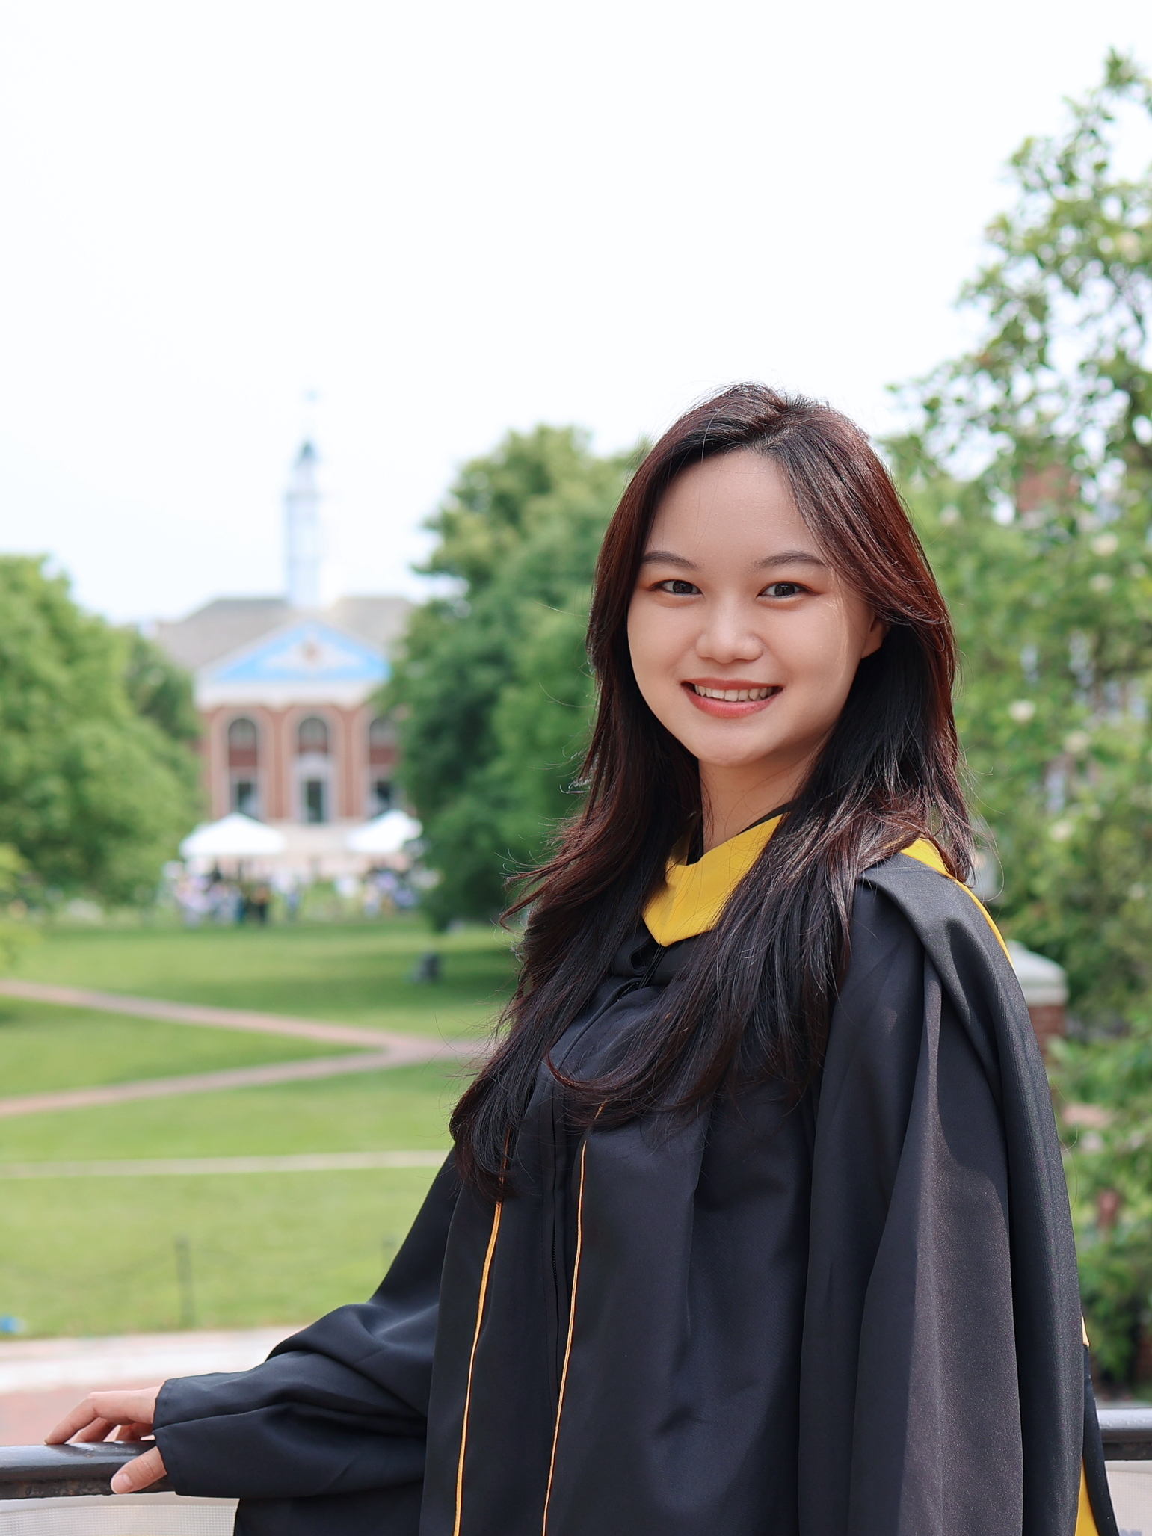

Introductions to Bioinformatics instructors (WashU team)
Malachi Griffith Professor of Medicine Professor of Genetics
Assistant Director, MGI
Obi Griffith
Professor of Medicine Professor of Genetics
Assistant Director, MGI
Chris Miller
Associate Professor of Medicine
Felicia Gomez
Assistant Professor of Medicine
Charlz Jerold
Bioinformatics Research Analyst
My Hoang
Graduate Student
Mariam Khanfar
Graduate Student
Kartik Singhal
Graduate Student
Jennie Yao
Graduate Student
griffithlab.org
rnabio.org genviz.org pmbio.org
civicdb.org pvactools.org dgidb.org
regtools.org vatools.org

Slide 4
Introductions to Bioinformatics instructors (WashU team)
Beard
Malachi Griffith Professor of Medicine Professor of Genetics
Assistant Director, MGI
Obi Griffith
Professor of Medicine Professor of Genetics
Assistant Director, MGI
Chris Miller
Associate Professor of Medicine
Felicia Gomez
Assistant Professor of Medicine
Charlz Jerold
Bioinformatics Research Analyst
My Hoang
Graduate Student
Mariam Khanfar
Graduate Student
Kartik Singhal
Graduate Student
Jennie Yao
Graduate Student
griffithlab.org
rnabio.org genviz.org pmbio.org
civicdb.org pvactools.org dgidb.org
regtools.org vatools.org

Slide 5
Introductions to Bioinformatics instructors (WashU team)
No Beard
Malachi Griffith Professor of Medicine Professor of Genetics
Assistant Director, MGI
Obi Griffith
Professor of Medicine Professor of Genetics
Assistant Director, MGI
Chris Miller
Associate Professor of Medicine
Felicia Gomez
Assistant Professor of Medicine
Charlz Jerold
Bioinformatics Research Analyst
My Hoang
Graduate Student
Mariam Khanfar
Graduate Student
Kartik Singhal
Graduate Student
Jennie Yao
Graduate Student
griffithlab.org
rnabio.org genviz.org pmbio.org
civicdb.org pvactools.org dgidb.org
regtools.org vatools.org

Slide 6
Student poll (respond in slack)
Not counting the pre-requisites and materials for this course:
Do you consider yourself a bioinformatician? Computational biologist?
Are you familiar with linux/command line?
Intermediate?
Expert?
Do you sometimes write code?
Are you familiar with R?
Intermediate?
Expert?
Do you use git/github?
What organism do you work with? (Put an animal emoji in slack)
Are you interested in bulk RNAseq, scRNAseq, or both?

Slide 7
Learning objectives of the course
Module 1: Introduction to RNA Sequencing
Module 2: Alignment and Visualization
Module 3: Expression and Differential Expression
Module 4: Alignment Free Expression Estimation
Tutorials
Provide a working example of an RNA-seq analysis pipeline
Run in a ‘reasonable’ amount of time with modest computer resources
Self contained, self explanatory, portable

Slide 8
Learning objectives of module 1
Introduction to the theory and practice of RNA sequencing (RNA-seq) analysis
Background molecular biology
Challenges specific to RNA-seq
General goals and themes of RNA-seq analysis workflows
Common technical questions related to RNA-seq analysis
Introduction to the RNA-seq hands on tutorial

Slide 9
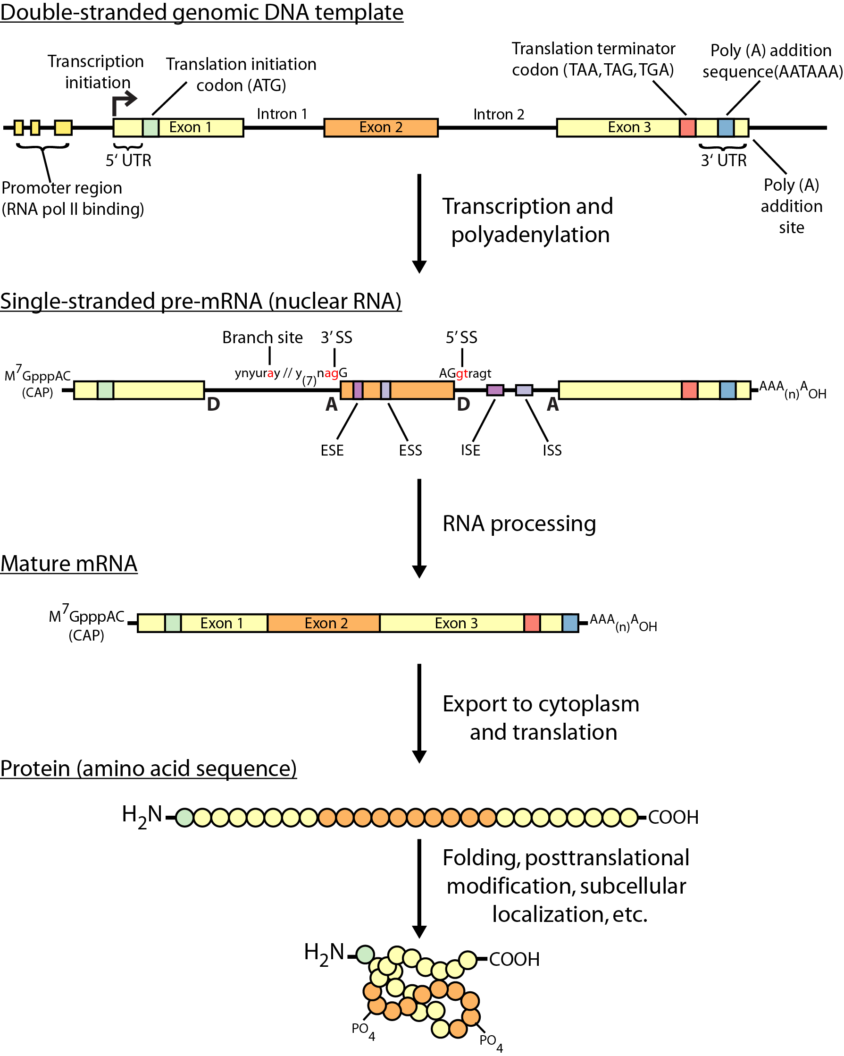
Gene expression (brief review of central dogma)
Thinking about the molecular biology here, what is actually being sequenced in an RNA-seq experiment?
Does it differ depending on the sequencing platform? Or for bulk vs single cell sequencing?

Slide 10
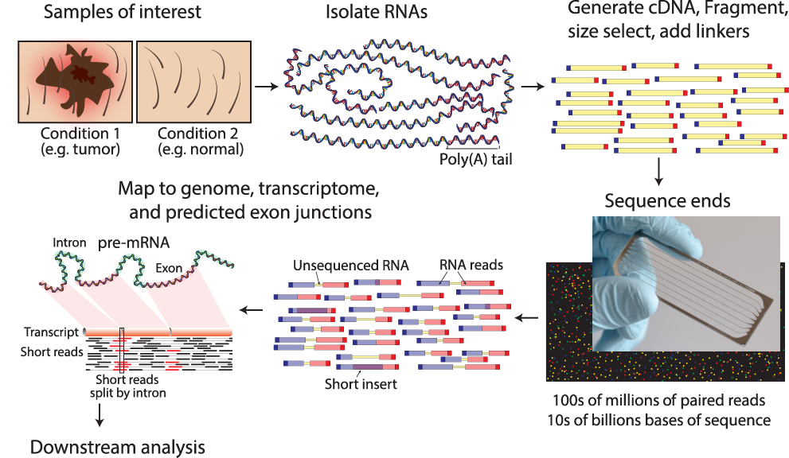
RNA sequencing overview
Notes:
Notes on paired end read depiction:
Each line depicts a sequenced fragment. These consist of adapters, and portions sequenced from each end
Blue is being used to indicated read 1, and red for read 2
If the fragment is long enough relative to the read sequence length, there will be a portion in the middle that is not sequenced
Read1 and Read2 can also overlap
Note the portion

Slide 11
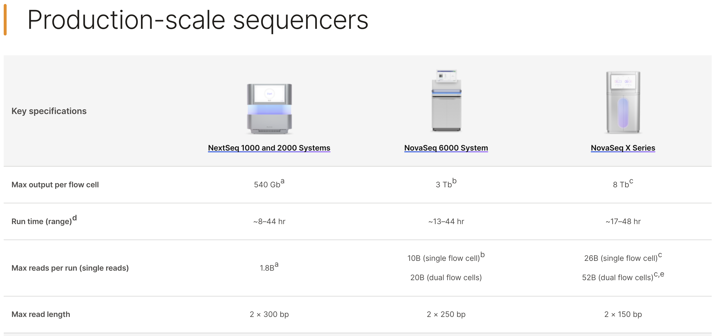
MPS (NGS) Platforms: Illumina is currently dominant
Higher accuracy, range of capacity and throughput
Slightly longer read lengths on some platforms

Slide 12
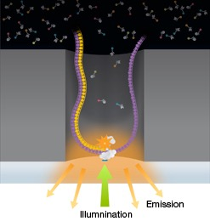
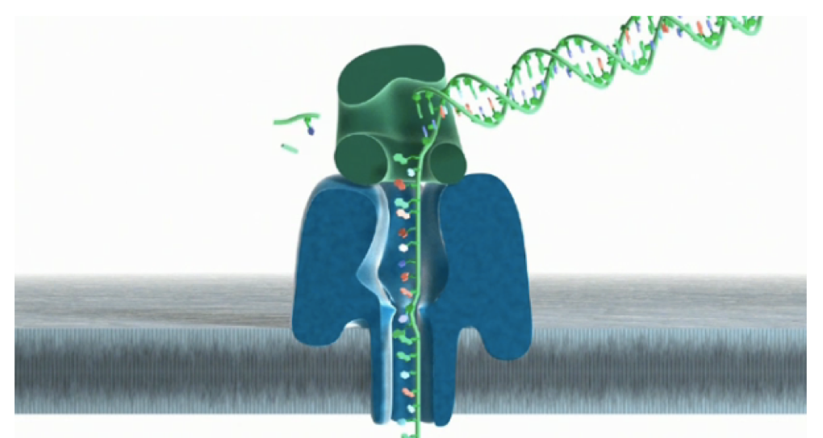
Next-next (3rd) generation sequencing platforms
Defining Characteristics: Long reads (10-100 kb) from single molecules.
Pacific Biosciences: watching a polymerase synthesize DNA/cDNA in real time
Oxford Nanopore: Translocating DNA/RNA through a nanopore with electrode-based detection
The promise: Long reads will allow us to accurately sequence and assemble whole human genomes, from scratch, without using the reference genome.
Status: Currently limited by lower throughput, higher base error rate and higher cost. 3rd generation technologies have proven useful, but generally for niche applications so far.
Notes:
PacBio: Zeromode waveguide (ZMW) well with a polymerase immobilized in the bottom binds to special hairpin adaptors. As DNA synthesis occurs each fluorescently labeled nucleotide emits light to allow real time sequencing.

Slide 13
Challenges specific to RNA sequencing
Sample
Purity?, quantity?, quality?
RNAs consist of small exons that may be separated by large introns
Mapping reads to genome is challenging
The relative abundance of RNAs vary wildly
10⁵ – 10⁷ orders of magnitude
Since RNA sequencing works by random sampling, a small fraction of highly expressed genes may consume the majority of reads
Ribosomal and mitochondrial genes
RNAs come in a wide range of sizes
Small RNAs must be captured separately
PolyA selection of large RNAs may result in 3’ end bias
RNA is fragile compared to DNA (easily degraded)

Slide 14
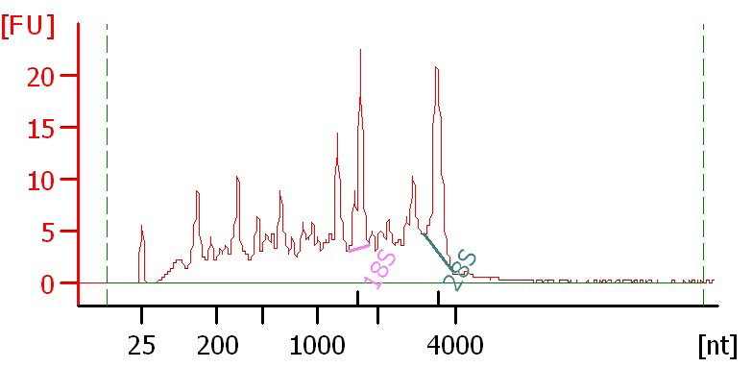
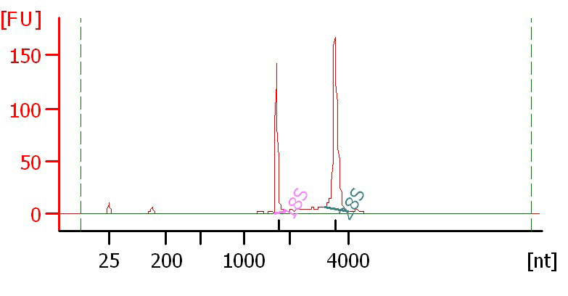
Agilent example / interpretation
https://goo.gl/uC5a3C
‘RIN’ = RNA integrity number
0 (bad) to 10 (good)
RIN = 6.0
RIN = 10

Slide 15
There are many RNA-seq library construction strategies
Total RNA versus polyA+ RNA?
Ribo-reduction?
Size selection (before and/or after cDNA synthesis)
Small RNAs (microRNAs) vs. large RNAs?
A narrow fragment size distribution vs. a broad one?
Linear amplification?
Stranded vs. un-stranded libraries
Library normalization?
Exome captured vs. un-captured
These details can affect analysis strategy
Especially comparisons between libraries

Slide 16
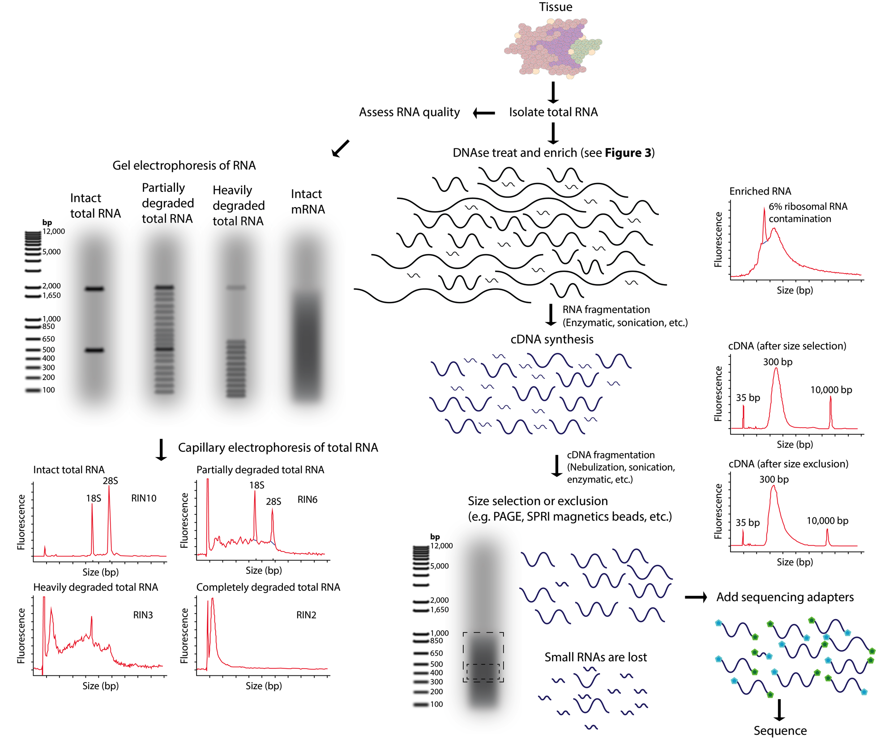
Fragmentation and size selection
Notes:
- RNA-seq library construction may involve both fragmentation and size selection. These procedures may be modified according to the integrity and amount of starting total RNA. The distributions of RNA molecule sizes are depicted for input total RNA and at various stages during the process of RNA/cDNA fragmentation and size selection. Commonly used methods for fragmentation and size selection are depicted along with the expected output of a quality-control assay at each stage (in the form of a capillary electrophoresis trace). Note that in the final library, it is typical that the majority of RNAs below a certain size (typically <150–200 bp) are underrepresented. Refer to S3 Table and S7 Table for more details on many of the concepts depicted in this figure.

Slide 17
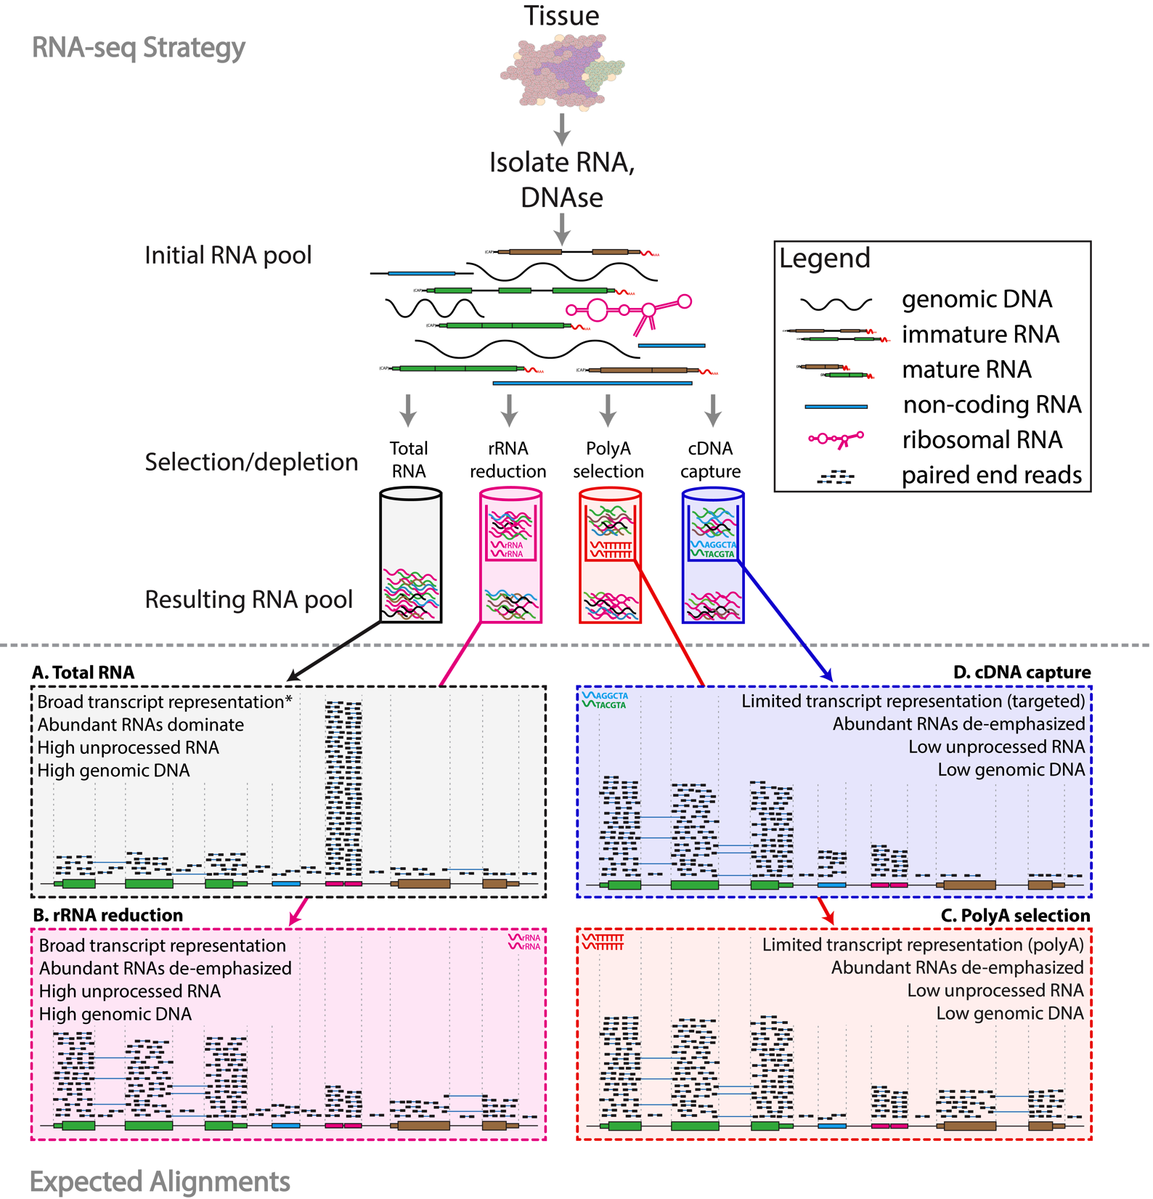
RNA sequence enrichment (selection/depletion)
Notes:
RNA-seq library enrichment strategies that influence interpretation and analysis. RNA-seq library construction protocols differ widely, and these differences have significant consequences for data interpretation and analysis. The figure above illustrates representative alignment results for either total RNA or one of three commonly used enrichment strategies at a hypothetical genomic locus with very highly expressed ribosomal RNA (pink), highly expressed protein coding (green), lowly expressed protein coding (brown) and lowly expressed noncoding RNA (blue) genes. (A) If total RNA is sequenced without enrichment, the vast majority of reads correspond to a small number of very highly expressed RNA species such as ribosomal RNAs (rRNAs). In humans, ~95%–98% of all RNA molecules may be rRNAs. A significant amount of genomic DNA (gDNA) and unprocessed heteronuclear RNA (hnRNA, also known as pre-mRNA) contamination may also remain after typical RNA isolation procedures. As a result, most reads will align to intronic, intergenic, and especially to ribosomal gene regions. Since analysis of these molecules is rarely the target of RNA-seq, various enrichment strategies are commonly employed. The amount of gDNA contamination in total RNA can be reduced, but not entirely eliminated, by use of a deoxyribonuclease (DNase) treatment. The amount of unprocessed RNA can be reduced, but not entirely eliminated, by employing an RNA isolation method that attempts to keep nuclei intact and removing these to enrich for mature mRNAs present in the cytoplasmic compartment. Additional strategies are discussed in S3 Table.
* When sequencing total RNA, a complete representation of the transcriptome is theoretically present, but in practical terms, insufficient sequence reads are obtained to sufficiently sample all transcripts of all types, and some enrichment strategy is required to reduce extremely abundant rRNA species. (B) Selective rRNA reduction kits use oligonucleotides complementary to ribosomal sequences to specifically reduce the abundance of rRNAs while maintaining a broad representation of transcript species. Since the oligonucleotide probes used in these kits are only designed to bind to and deplete rRNA sequences, a significant amount of unprocessed RNA and gDNA contamination may remain. (C) Poly(A) selection and (D) cDNA capture methods specifically enrich for (primarily) mature polyadenylated RNA species or specific targets (e.g., all known transcript exons), respectively. Since poly(A) selection specifically targets RNAs that have been polyadenylated—a modification that happens at the end of the transcription process—poly(A) selection results in an enrichment for mature, completely processed RNAs. Poly(A) selection and cDNA capture methods sacrifice some transcriptome representation for increased signal to noise for transcripts of greater interest. Poly(A) methods will fail to represent most noncoding and other nonpolyadenylated RNAs. Capture methods on the other hand will under-represent any loci not specifically included in the capture design. For example, in this case the brown gene was not included in the design, and therefore, expression of this gene would be underestimated. Each of the methods depicted here has advantages and disadvantages (S3 Table and S7 Table). Furthermore, the relative amounts of each class of RNA depicted in each panel are hypothetical examples meant to demonstrate the goals and principles of each enrichment strategy and should not be interpreted quantitatively. Refer to S4 Table for additional information on the effect of each enrichment strategy.

Slide 18
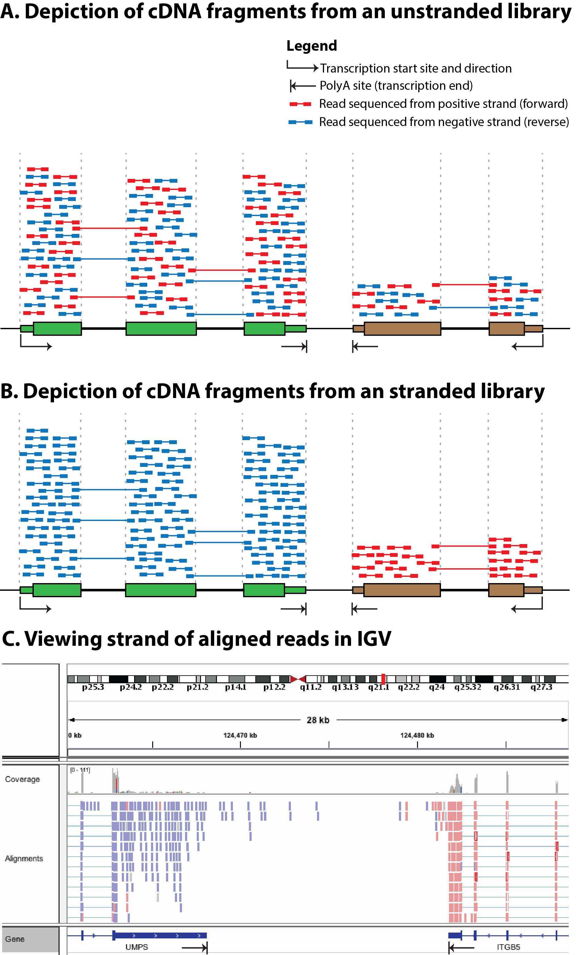
Stranded vs. unstranded
https://rnabio.org/module-09-appendix/0009/12/01/StrandSettings/
(detailed discussion and cheat sheet)
Notes:
Comparison of stranded and unstranded RNA-seq library methods and their influence on interpretation and analysis. (A) Many RNA-seq library construction protocols do not maintain the strand identity of RNA transcripts in the sequence data (S1 Table). In these “unstranded” strategies, doublestranded cDNA is sequenced, and knowledge of the transcription strand of the RNA molecule is lost. This results in an even mix of reads from both strands. In panel A, a gene transcribed on the positive strand is shown in green, a second gene transcribed on the negative strand is shown in brown, and a third gene transcribed on the positive strand (partially overlapping the second gene) is shown in yellow. The first two genes are protein coding with the open reading frame (ORF) portion depicted as thick rectangles and the UTRs depicted as thin rectangles. The third gene is a noncoding RNA gene. Aligned paired-end read sequences (read 1 and read 2) are depicted as short colored bars connected by thin lines. The thin connecting line in each read pair depicts the portion of the cDNA fragment that remains unsequenced when the cDNA fragment is larger than two times the read length. Each read is colored according to the strand sequenced, blue for the positive (forward/sense) strand and red for the negative (reverse/antisense) strand. Using known annotations, the mapped position of each read, and knowledge of exon splicing patterns, the likely transcription strand of some reads can be inferred. However, for many aligned reads the transcription strand cannot be inferred and sense-antisense expression analysis is not possible. Note that for each gene, an approximately equal proportion of reads corresponding to each strand are observed. Also note that read pairing information can sometimes be used to infer which gene a read was likely derived from. These reads are referred to as “encompassing” read pairs, in which one read of a pair aligns within one exon and the second read of a pair aligns within another exon. However, reads that align within a region corresponding to overlapping genes cannot be unambiguously assigned to either gene (e.g., the portion of the brown and yellow genes that overlap). Note that in this figure we are not depicting any reads in which a single read of a read pair spans across an intron. These exon–exon “spanning” reads can usually be matched unambiguously to a transcript, even in an unstranded library, because the exon–exon junction alignments line up with known splice sites and exon boundaries. (B) More recent “stranded” RNA-seq library strategies allow the strand information to be retained. In the resulting alignments, depicted in panel B, the strand of the alignment corresponds in a predictable way to the transcription strand of the sequenced RNA molecule. Now we see that reads aligning within a gene are indicated as being derived from the expected transcription strand for that gene. Furthermore, in regions where two genes overlap on opposite strands, we can now unambiguously assign reads to each gene. (C) When strand information is maintained by the RNA-seq protocol, it can be visualized in genome browsers such as IGV [62]. For example, to make IGV color read alignments according to strand, use the “Color alignments” by “First-of-pair strand” setting (refer to S5 Table for more strand-related software settings).

Slide 19
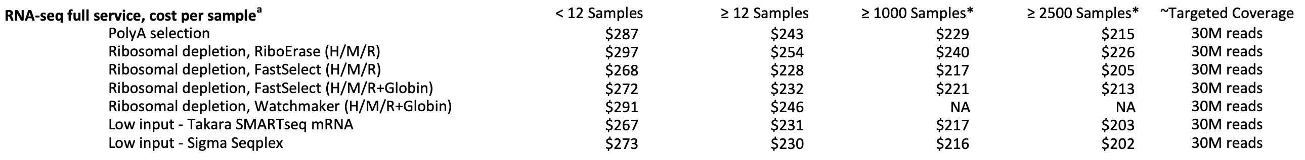
Ordering RNA-seq data, “coverage”, and cost?
An example menu from a sequencing core facility (circa 2024)
Options primarily relate to method of enrichment and input amounts
“Coverage” is a non-intuitive concept in bulk-RNAseq.
30M reads is sufficient for gene abundance estimation (increase for other applications)

Slide 20
Common analysis goals of RNA-Seq analysis (what can you ask of the data?)
Gene expression and differential expression
Alternative expression analysis
Transcript discovery and annotation
Allele specific expression
Relating to SNPs or mutations
Mutation discovery
Fusion detection
RNA editing

Slide 21
General themes of RNA-seq workflows
Each type of RNA-seq analysis has distinct requirements and challenges but also a common theme:
Obtain raw data (convert format)
Align/assemble reads
Process alignment with a tool specific to the goal
e.g. ‘stringtie’ for expression analysis, ‘star-fusion’ for fusion detection, etc.
Post process
Import into downstream software (R, python, WebGestalt, etc.)
Summarize and visualize
Create gene lists, prioritize candidates for validation, etc.

Slide 22
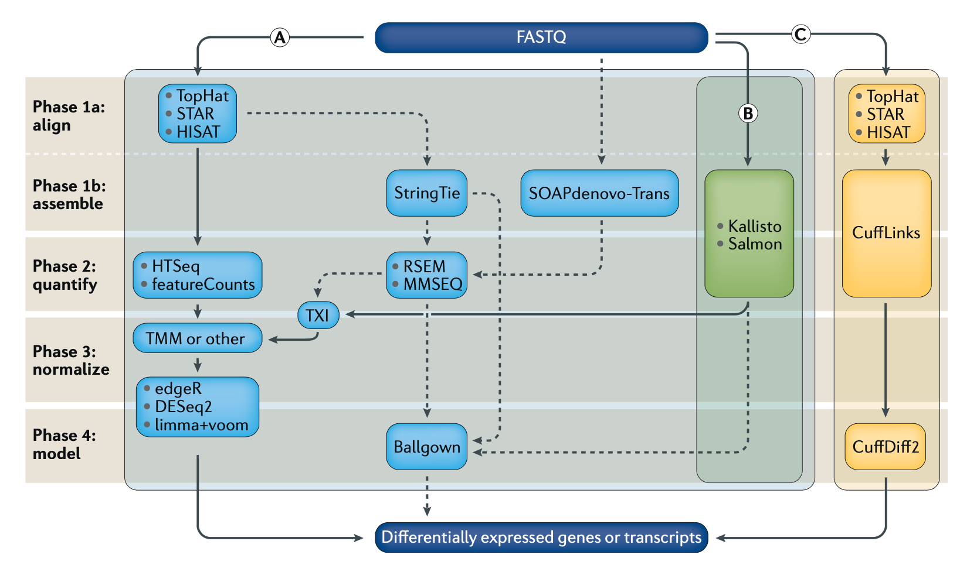
Examples of RNA-seq data analysis workflows for differential gene expression
RNA sequencing: the teenage years
Covered in rnabio.org
Notes:
RNA-seq data analysis workflow for differential gene expression. Computational analysis for differential gene expression (DGE) begins with raw RNA sequencing (RNA-seq) reads in FASTQ format and can follow a number of paths. Three popular workflows (A, B and C, represented by the solid lines) are given as examples, and some of the more common alternative tools (represented by the dashed lines) are indicated. In workflow A, aligners such as TopHat, STAR or HISAT2 use a reference genome to map reads to genomic locations, and then quantification tools, such as HTSeq and featureCounts, assign reads to features. After normalization (usually using methods embedded in the quantification or expression modelling tools, such as trimmed mean of M-values (TMM)), gene expression is modelled using tools such as edgeR, DESeq2 and limma+voom, and a list of differentially expressed genes or transcripts is generated for further visualization and interpretation. In workflow B, newer, alignment-free tools, such as Kallisto and Salmon, assemble a transcriptome and quantify abundance in one step. The output from these tools is usually converted to count estimates (using tximport (TXI)) and run through the same normalization and modelling used in workflow A, to output a list of differentially expressed genes or transcripts. Alternatively, workflow C begins by aligning the reads (typically performed with TopHat, although STAR and HISAT can also be used), followed by the use of CuffLinks to process raw reads and the CuffDiff2 package to output transcript abundance estimates and a list of differentially expressed genes or transcripts. Other tools in common use include StringTie, which assembles a transcriptome model from TopHat (or similar tools) before the results are passed through to RSEM or MMSEQ to estimate transcript abundance, and then to Ballgown to identify differentially expressed genes or transcripts, and SOAPdenovo-trans, which simultaneously aligns and assembles reads for analysis via the path of choice.

Slide 23
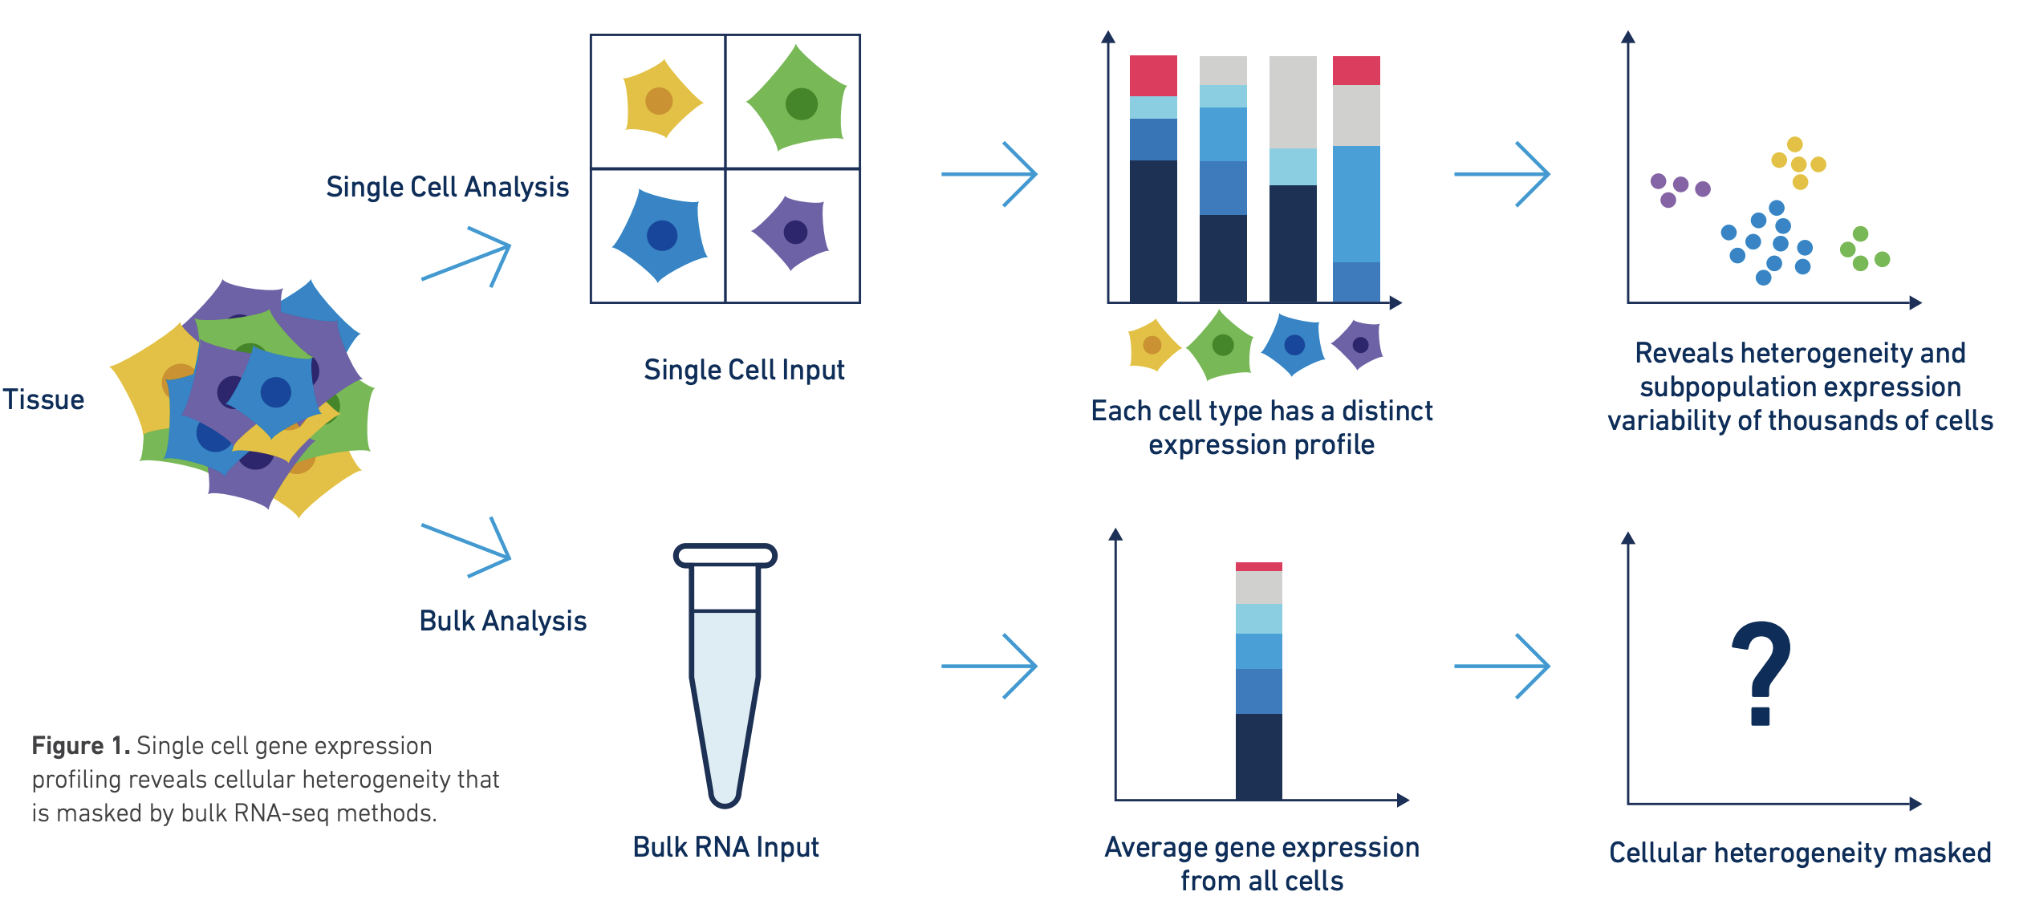
Discussion of bulk vs single cell RNA-seq
Image from 10x genomics
Factors to compare: Cost, complexity of library prep, complexity of analysis, qualitative and quantitative differences in richness of information obtained.
Notes:
Simple differences. Cost. 200 million reads gives you a rich representation of transcriptome in bulk context but signal is averaged across cells. 500 million reads in an scRNA-seq experiment by contrast gives you are relatively sparse view of the transcriptome of 4-10k individual cells.
Simple differences. Complexity of library prep and analysis is higher for scRNA.
Most importantly. Single cell data gives information about individual cells. In bulk RNAseq analysis the signal from multiple cells is average together. Deconvolution approaches are possible with bulk RNA-seq but hard. Single cell becomes more valuable depending on how heterogeneous your sample is, and how important it is to understand the composition of cell types present and interaction between cells.
Bulk RNA-seq is giving a readout of more cells, way, way, way more cells
Bulk RNA-seq can robustly detect gene expressed at a very low copy number per cell
Bulk RNA-seq can provide information from the whole length of transcripts. Single cell protocols remain end biased. This has implications for detecting expression of variant alleles, isoform quantification, fusion detection, etc.
Support for long read sequencing platforms is in the early stages for the scRNA approach
Bulk RNAseq can be done with very minimal manipulation of cells. The result may be a relatively unbiased survey of transcripts in that tissue. polyA transcripts and those that are not. Long transcripts, short transcripts, abundant and rare. Transcripts from cells that are fragile. Transcripts from cells that are large and small.

Slide 24
Common questions (and answers)
Supplementary Table 7
Malachi Griffith*, Jason R. Walker, Nicholas C. Spies, Benjamin J. Ainscough, Obi L. Griffith*. 2015. Informatics for RNA-seq: A web resource for analysis on the cloud. 11(8):e1004393. 2015.
http://journals.plos.org/ploscompbiol/article?id=10.1371/journal.pcbi.1004393

Slide 25
Introduction to tutorial
(Module 1)

Slide 26
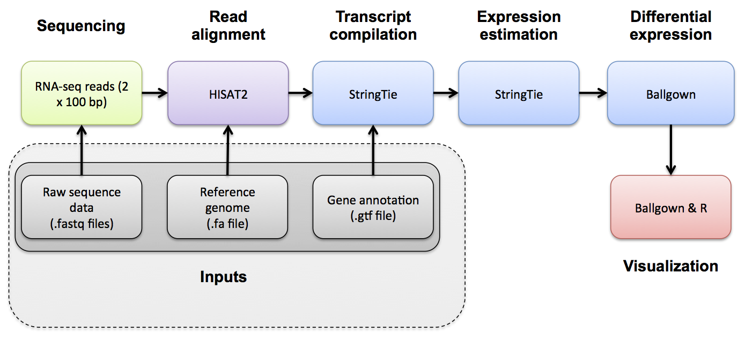
HISAT2/StringTie/Ballgown RNA-seq Pipeline
Module 1

Slide 27
Bioinformatics troubleshooting cheat sheet
Check your inputs!
Mix of incompatible reference genomes used (see this tutorial)
Mix of incompatible gene/transcript identifiers
Reference sequence names (e.g. “1” vs “chr1”)
1-based vs 0-based coordinates (see this tutorial)
Computational tasks fail due to resource limitations (memory and storage)
Dependency hell for bioinformatics tools. Learn to use containers (e.g. docker) or environment managers (e.g. conda)

Slide 28





We are on a Coffee Break & Networking Session
Workshop Sponsors:

